Slide 1
IAM

Slide 2
What is IAM
IAM stands for Identity Access Management
These can be formed by AWS and Other resources
These IAM has separate user name and separate password
IAM is a free service
IAM is a security service

Slide 3
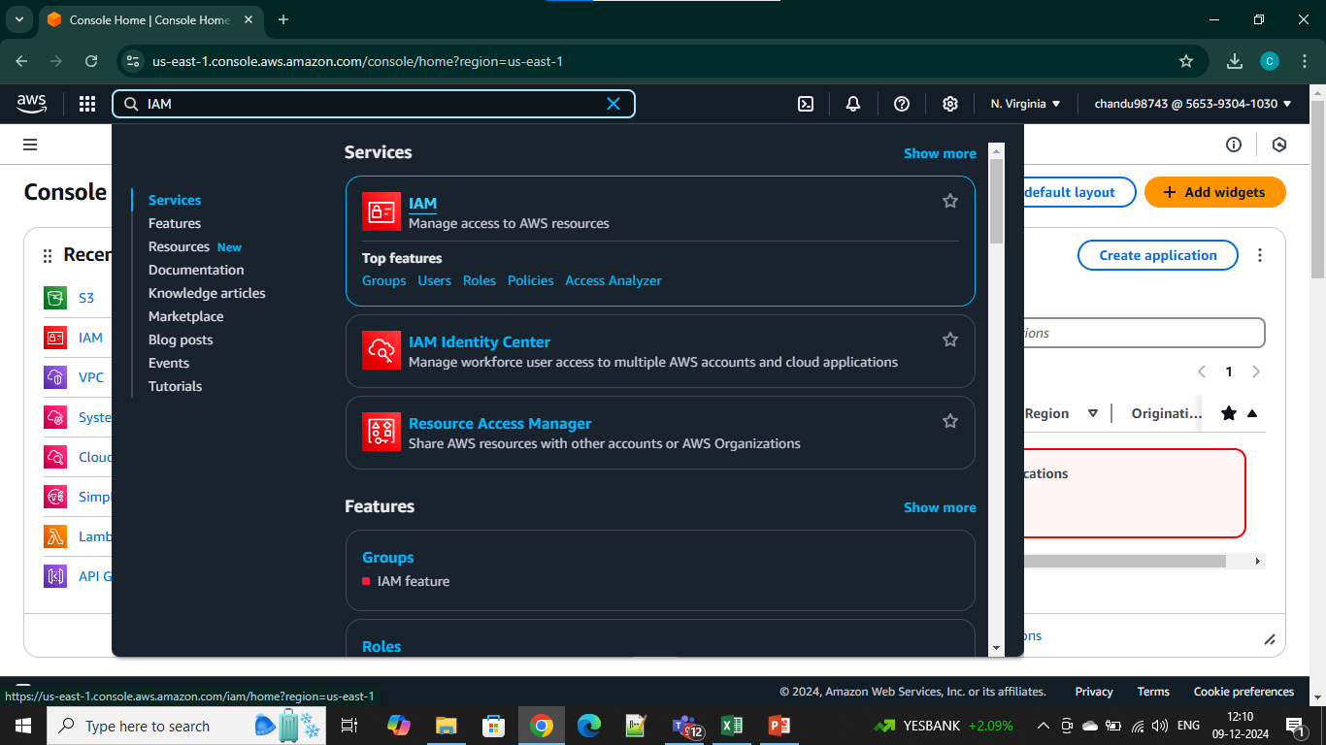

Slide 4
IAM User
IAM user is an entity where we can personalities and names
5 users run at a time
A user name and password can be formed by AWS account and AWS console

Slide 5
Steps to Create an IAM User:
Log in to the AWS Management Console.
Navigate to the IAM Dashboard.
Choose Users and then Add User.
Specify a username and password choose the access type
Assign permissions
Directly attach policies.

Slide 6
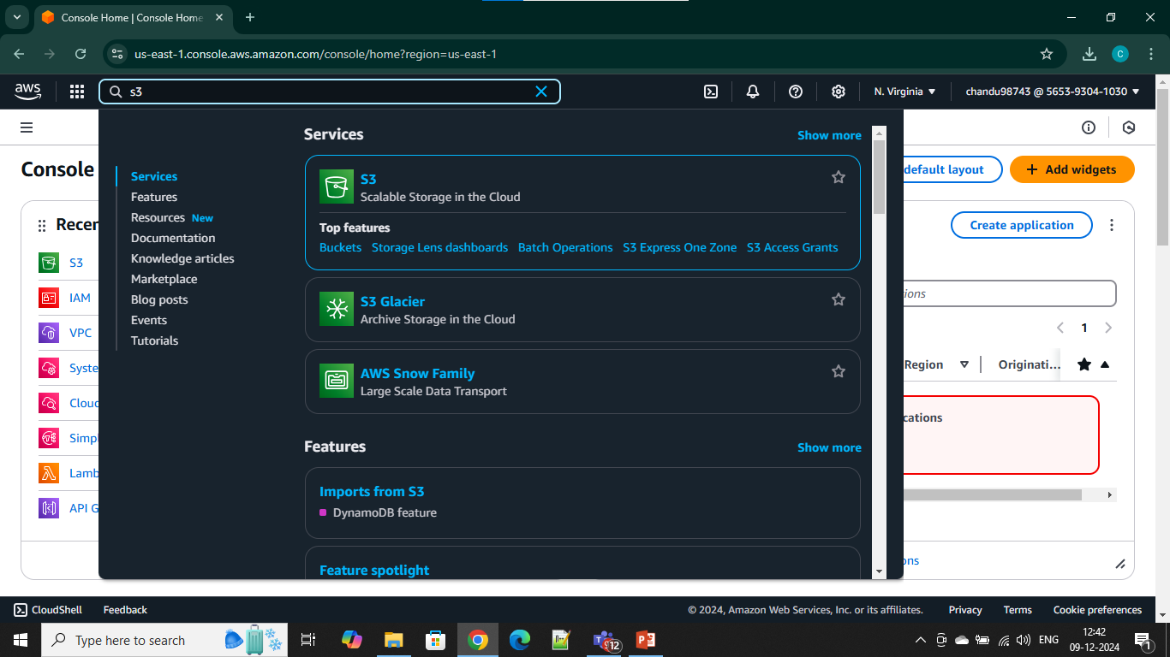
S3FULL ACCESS

Slide 7
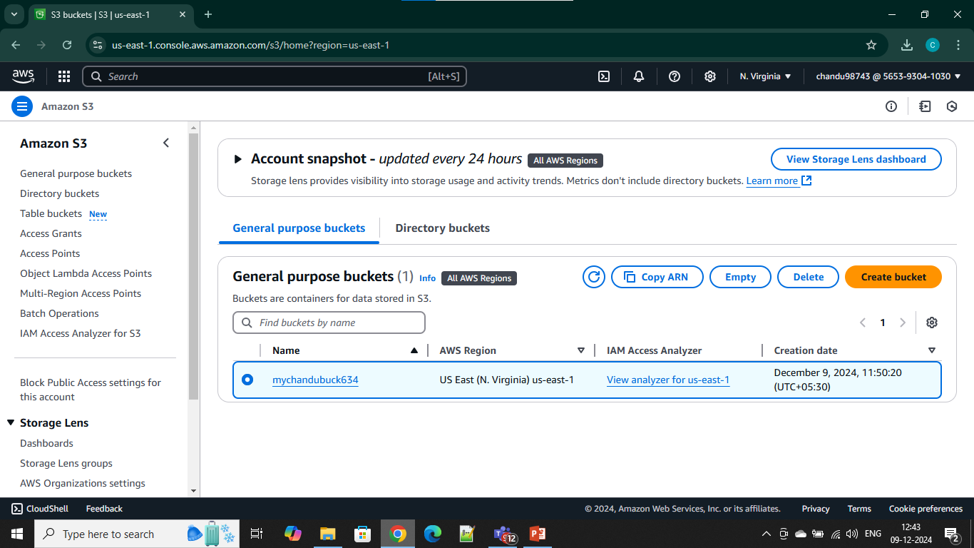
Create Bucket

Slide 8
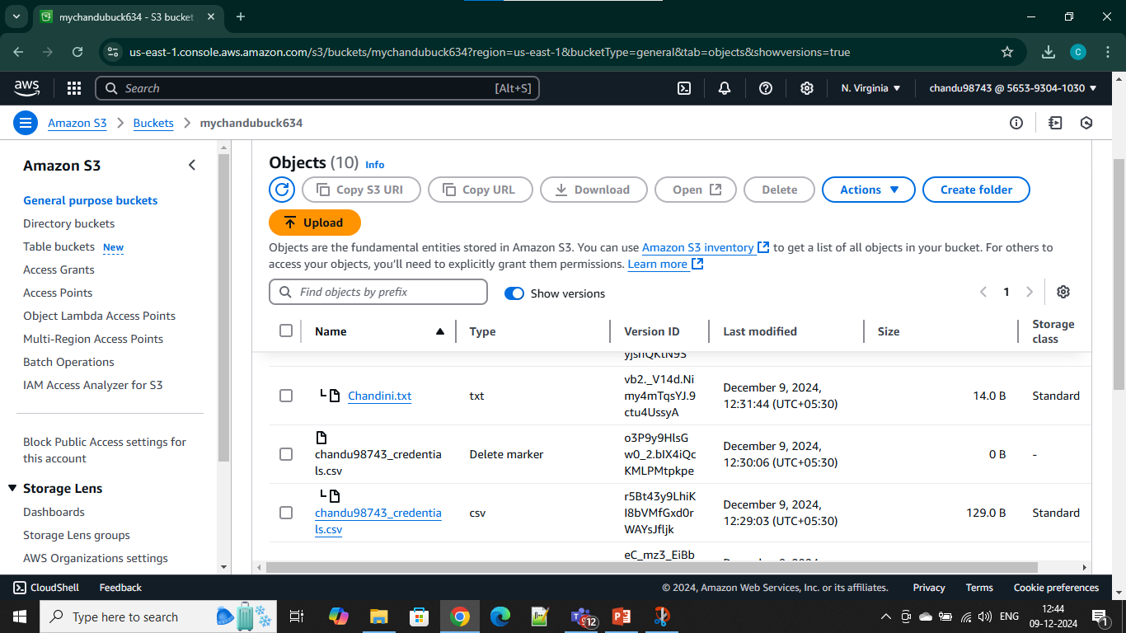
Versionig

Slide 9
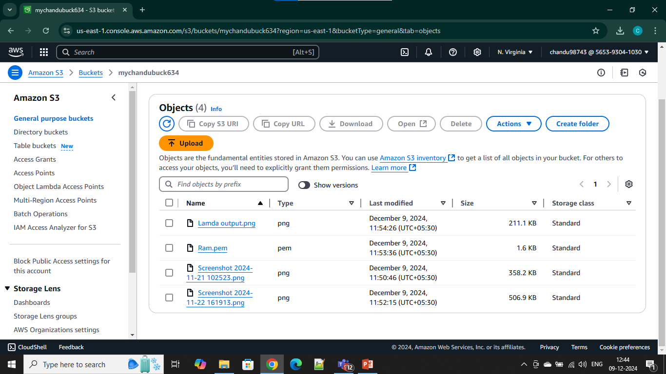
Upload Files

Slide 10
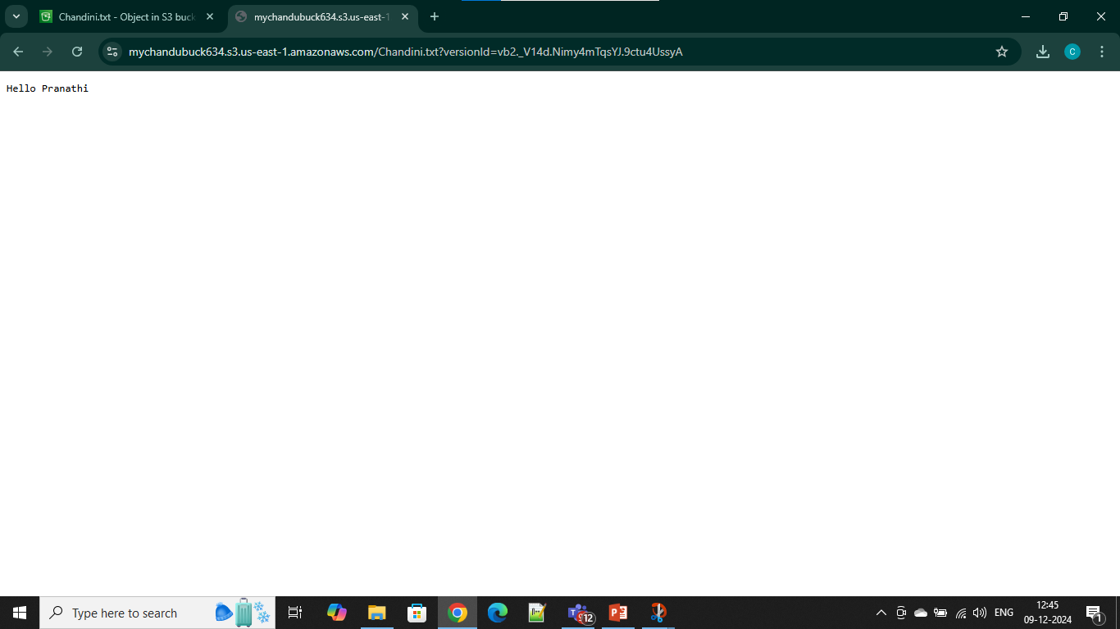
OUTPUT

Slide 11
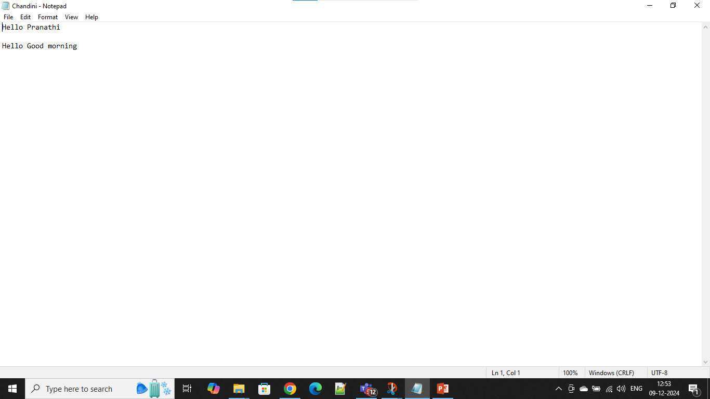
Modified File

Slide 12
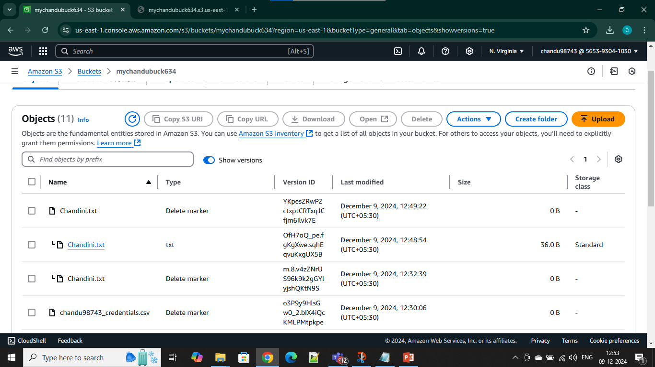
Updated Versioning

Slide 13
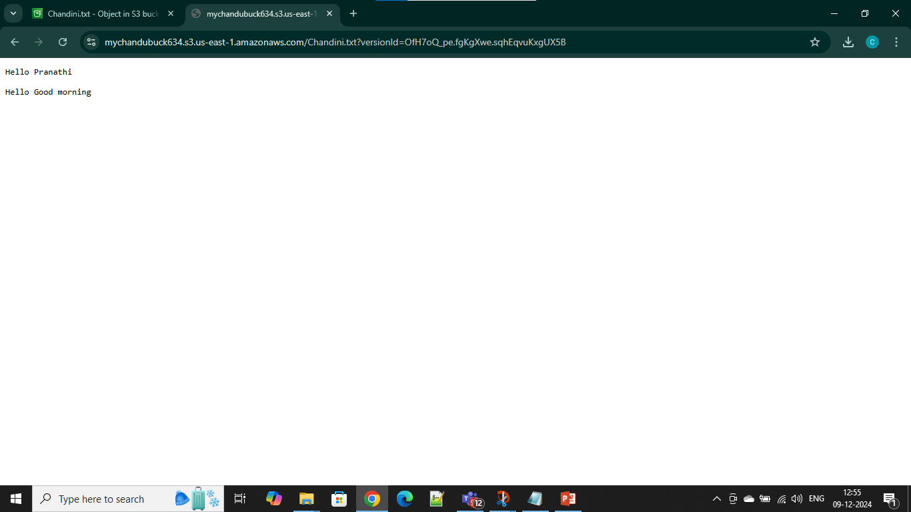
Final Output

